Slide 1
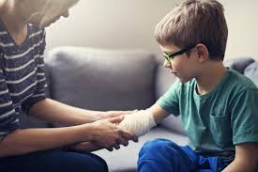
Burns in Children
Student’s Name
Institution of Affiliation
Course Code and Name
Professor
Date

Slide 2
Definition
Burns – Injuries that result from direct contact or exposure to any physical, thermal, chemical, electrical, or radiation source
Categories/Types:
1) Thermal Injury
Moist heat - Scald
Dry heat
– Flame Burns
- Flash burns due to exposure to natural gas, alcohol, combustible liquids
-Contact burns
2) Electrical Injury – High & Low voltage
3) Chemical Burns – acid/alkali
4) Ionizing radiation
5) Cold injury – frost bite
6) Sun burns

Slide 3
Epidemiology
Unintentional injury is the leading cause of death among children under the age of 16 (Krishnamoorthy, Ramaiah, & Bhananker, 2012)
Leading causes of accidental injuries at home are:
Burns, Drowning, Suffocation, Chocking, Poisonings, Falls, and Firearms (John Hopkins Medicine, 2020).
Burns and fires are the 5th most common cause of accidental death in children and adults (Toon et al., 2011)
They account for an estimated 3,500 adult and child deaths per year (John Hopkins Medicine, 2020).

Slide 4
Scald Injuries
Definition
A scald is a burn from close contact with hot liquid or steam.
Epidemiology
Scalds are the most common type of burn affecting young children (Toddlers and children)
Nearly 75% of all scalding burns in children are preventable
Most children ages 4 and under who are hospitalized for burn-related injuries suffer from scald burn (65%) or contact burns (20%) (John Hopkins Medicine, 2020).
The greatest number of pediatric burn [patients are infants and toddlers younger than 3 years of age burned by scalding liquid (John Hopkins Medicine, 2020).

Slide 5

Scald Injuries
Common causes
Hot water
Coffee
Tea
Soup
Hot tap Water ( - burns causes more deaths and hospitalizations than burns from any other hot liquids (John Hopkins Medicine, 2020))
Hot liquids from the microwave

Slide 6
Contact Burns
Definition
A burn by touching a hot objects - metal or material
Epidemiology
It accounts for 20% of all hospitalizations in children admitted because of burns
Causes
Touching hot:
Burners of a stove
Skillet or grill

Slide 7
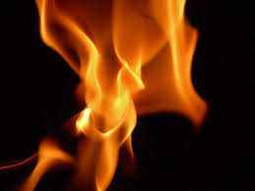
Flame Burns
Definition
As the name suggests
Burns resulting from direct or indirect contact with a flame
Causes:
Flames occur from a triad of an ignition source, an oxidizing agent, and a fuel source (Walker & King, 2019).

Slide 8
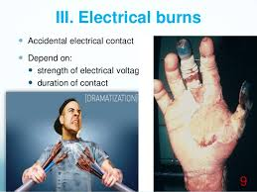
Electrical Burns
Definition
A burn due to accidental electrical contact
Severity of the burn depends on:
Strength, type, and amount of the electrical voltage
Duration of contact
Area of contact
Pathophysiology:
Depends on the voltage, current flow, and resistance of the skin
High-voltage electric current has irreversible localized and systemic consequences, with a high percentage of disability

Slide 9
Chemical Burns
Definition
Burns caused by acids or bases that come into contact with the skin or body tissues
Causes
Acids (Sulfuric acid, Nitric acid, Hydrochloric acid)
Bases (Calcium, sodium, & potassium hydroxide, Ammonia, )
Oxidants (Bleaches and Chlorites, Peroxides, Chromate)
Vesicants (Sulfur, nitrogen, mustards, arsenicals)
Other substances (white phosphorus, Metals, Hair coloring agents, Airbag injuries)

Slide 10
Factors Contributing to the depth of burn injuries
Temperature of the agent
Duration of contact
Concentration of agent

Slide 11
References
John Hopkins Medicine (2020). Burns in Children. Retrieved from https://www.hopkinsmedicine.org/health/conditions-and-diseases/burns/burns-in-children
Krishnamoorthy, V., Ramaiah, R., & Bhananker, S. (2012). Pediatric Burn Injuries. Int J Crit Illn Inj Sci., 2(3): 128-134
Toon, M., Maybauer, D., Arceneaux, L., Fraser, J., Meyer, W., Runge, A., & Maybauer, M. (2011). Children with Burn Injuries-Assessment of Trauma, Neglect, Violence, and Abuse. J Inj Violence Res., 3(2): 98-110
Walker, N. & King, K. (2019). Acute and Chronic Thermal Burn Evaluation and Management. StatPearls [Internet]

